Slide 1
Perceptrons
Learning in Neural Networks

Slide 2
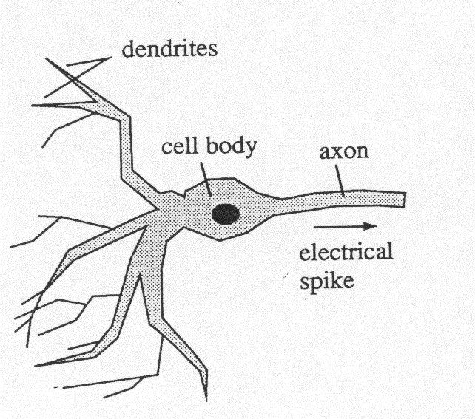

Natural versus Artificial Neuron
Natural Neuron McCullough Pitts Neuron

Slide 3
One Neuron
McCullough-Pitts
This is very complicated. But abstracting the details,we have
x1
w1
Σ
x2
w2
wn
Ιntegrate
Τhreshold
xn
Integrate-and-fire Neuron

Slide 4
Perceptron
weights
A
Pattern Identification
(Note: Neuron is trained)

Slide 5
Three Main Issues
Representability
Learnability
Generalizability

Slide 6
One Neuron
(Perceptron)
What can be represented by one neuron?
Is there an automatic way to learn a function by examples?

Slide 7

Feed Forward Network
weights
weights
A

Slide 8
Representability
What functions can be represented by a network of McCullough-Pitts neurons?
Theorem: Every logic function of an arbitrary number of variables can be represented by a three level network of neurons.

Slide 9
Proof
Show simple functions: and, or, not, implies
Recall representability of logic functions by DNF form.

Slide 10
Perceptron
What is representable? Linearly Separable Sets.
Example: AND, OR function
Not representable: XOR
High Dimensions: How to tell?
Question: Convex? Connected?

Slide 11
AND

Slide 12
OR

Slide 13
XOR

Slide 14
Representability
Perceptron: Only Linearly Separable
  AND versus XOR
  Convex versus Connected
Many linked neurons: universal
  Proof: Show And, Or , Not, Representable
    Then apply DNF representation theorem

Slide 15
Learnability
Perceptron Convergence Theorem:
  If representable, then perceptron algorithm converges
  Proof (from slides)
Multi-Neurons Networks: Good heuristic learning techniques

Slide 16
Generalizability
Typically train a perceptron on a sample set of examples and counter-examples
Use it on general class
Training can be slow; but execution is fast.
Main question: How does training on training set carry over to general class? (Not simple)

Slide 17
Programming: Just find the weights!
AUTOMATIC PROGRAMMING (or learning)
One Neuron: Perceptron or Adaline
Multi-Level: Gradient Descent on Continuous Neuron (Sigmoid instead of step function).

Slide 18
Perceptron Convergence Theorem
If there exists a perceptron then the perceptron learning algorithm will find it in finite time.
That is IF there is a set of weights and threshold which correctly classifies a class of examples and counter-examples then one such set of weights can be found by the algorithm.

Slide 19
Perceptron Training Rule
Loop: Take an positive example or negative example. Apply to network.
  If correct answer, Go to loop.
  If incorrect, Go to FIX.
FIX: Adjust network weights by input example
  If positive example W_{new} = W_{old} + X; increase threshold
  If negative example W_{new} = W_{old} - X; decrease threshold
Go to Loop.

Slide 20
Perceptron Conv Theorem (again)
Preliminary: Note we can simplify proof without loss of generality
  use only positive examples (replace example X by –X)
  assume threshold is 0 (go up in dimension by
  encoding X by (X, 1).

Slide 21
Perceptron Training Rule (simplified)
Loop: Take a positive example. Apply to network.
  If correct answer, Go to loop.
  If incorrect, Go to FIX.
FIX: Adjust network weights by input example
  If positive example W_{new} = W_{old} + X
Go to Loop.

Slide 22
Proof of Conv Theorem
Note:
1. By hypothesis, there is a ε >0
such that V*X >ε for all x in F
1. Can eliminate threshold
(add additional dimension to input) W(x,y,z) > threshold if and only if
W* (x,y,z,1) > 0
2. Can assume all examples are positive ones
(Replace negative examples
by their negated vectors)
W(x,y,z) <0 if and only if
W(-x,-y,-z) > 0.

Slide 23
Perceptron Conv. Thm.(ready for proof)
Let F be a set of unit length vectors. If there is a (unit) vector V* and a value ε>0 such that V*X > ε for all X in F then the perceptron program goes to FIX only a finite number of times (regardless of the order of choice of vectors X).
Note: If F is finite set, then automatically there is such an ε.

Slide 24
Proof (cont).
Consider quotient V*W/|V*||W|.
(note: this is cosine between V* and W.)
Recall V* is unit vector .
= V*W*/|W|
Quotient <= 1.

Slide 25
Proof(cont)
Consider the numerator
Now each time FIX is visited W changes via ADD.
V* W(n+1) = V*(W(n) + X)
= V* W(n) + V*X
> V* W(n) + ε
Hence after n iterations:
V* W(n) > n ε (∗)

Slide 26
Proof (cont)
Now consider denominator:
|W(n+1)|² = W(n+1)W(n+1) =
( W(n) + X)(W(n) + X) =
|W(n)|**2 + 2W(n)X + 1 (recall |X| = 1)
< |W(n)|**2 + 1 (in Fix because W(n)X < 0)
So after n times
|W(n+1)|² < n (**)

Slide 27
Proof (cont)
Putting (*) and (**) together:
Quotient = V*W/|W|
> nε/ sqrt(n) = sqrt(n) ε.
Since Quotient <=1 this means
n < 1/ε².
This means we enter FIX a bounded number of times.
Q.E.D.

Slide 28
Geometric Proof
See hand slides.

Slide 29
Additional Facts
Note: If X’s presented in systematic way, then solution W always found.
Note: Not necessarily same as V*
Note: If F not finite, may not obtain solution in finite time
Can modify algorithm in minor ways and stays valid (e.g. not unit but bounded examples); changes in W(n).

Slide 30
Percentage of Boolean
Functions Representable by a Perceptron
Input Perceptrons Functions
1 4 4
2 16 14
3 104 256
4 1,882 65,536
5 94,572 10**9
6 15,028,134 10**19
7 8,378,070,864 10**38
8 17,561,539,552,946 10**77

Slide 31
What wont work?
Try XOR.

Slide 32
Convexity: Representable by simple extension of perceptron
Clue: A body is convex if whenever you have two points inside; any third point between them is inside.
So just take perceptron where you have an input for each triple of points

Slide 33
What wont work?
Example: Connectedness with bounded diameter perceptron.
Compare with Convex with
(use sensors of order three).

Slide 34
Connectedness: Not Representable

Slide 35
What about non-linear separable problems?
Find “near separable solutions”
Use transformation of data to space where they are separable (SVM approach)
Use multi-level neural networks

Slide 36
Multi-Level Neurons
Difficulty to find global learning algorithm like perceptron
But …
  It turns out that methods related to gradient descent on multi-parameter weights often give good results. This is what you see commercially now.

Slide 37
Applications
Detectors (e. g. medical monitors)
Noise filters (e.g. hearing aids)
Future Predictors (e.g. stock markets; also adaptive pde solvers)
Learn to steer a car!
Many, many others …

